Slide 1
SESSION 6
FINANCIAL PLANNING & ANALYSIS – 2
SCALER SCHOOL OF TECHNOLOGY

Slide 2
Learning Outcomes
Session 6: Cost-Volume-Profit (CVP) Analysis
By the end of the session, learners will be able to:
  Explain the concept and importance of Cost-Volume-Profit (CVP) analysis.
  Identify the relationship between costs, volume, sales and profit.
  Calculate contribution, P/V ratio, break-even point and margin of safety.
  Analyse the impact of changes in price, costs and volume on profitability.
  Evaluate and apply CVP analysis to support pricing, production and cost-control decisions.

Slide 3
Cost-Volume-Profit (CVP) Analysis
Full /Traditional Costing: Also called absorption costing. Under this method, both fixed and variable production overheads are included in the product cost.
Fixed production overheads are absorbed into the unit cost.
Sales
XXX
Less: Cost of goods sold
(XXX)
(Cost of production + Opening stock − Closing stock)
Gross profit
XXX
(Sales − Cost of goods sold)
Add/(Less): Over/(under)-absorbed OH
XXX
Actual fixed production OH vs. amount absorbed
Less: Selling & admin overhead
(XXX)
Fixed + variable
Net profit
XXX

Slide 4
Cost-Volume-Profit (CVP) Analysis
Marginal Costing: Also called variable costing, prepares the profit statement by separating variable costs from fixed costs, rather than by function (production, admin, selling) as in absorption costing.
Fixed costs are treated as period costs and charged in full to the period, not spread over units produced.
Sales
XXX
Less: Variable cost
(XXX)
Contribution
XXX
Sales − Variable cost
Less: Fixed cost
(XXX)
Profit
XXX
Contribution − Fixed cost

Slide 5
Cost-Volume-Profit (CVP) Analysis
Cost–Volume–Profit (CVP) Analysis is a management accounting technique used to understand how changes in costs, sales volume, selling price, and profit affect a business.
It rests on separating costs into fixed and variable components, then using the resulting cost-volume-profit relationships to find the break-even point and beyond.
It helps managers answer questions such as:
How many units must we sell to break even?
How many units must we sell to earn a target profit?
What happens to profit if sales volume increases or decreases?
What happens to profit if the selling price changes?
What happens to profit if variable or fixed costs change?
How much sales can fall before the business starts making a loss?

Slide 6
Cost-Volume-Profit (CVP) Analysis
Key Terms: is a management accounting technique used to understand how changes in costs, sales volume, selling price, and profit affect a business.
It rests on separating costs into fixed and variable components, then using the resulting cost-volume-profit relationships to find the break-even point and beyond.
Selling price (SP) — revenue per unit
Variable cost (VC) — cost per unit that changes with volume
Contribution margin (CM) = Selling Price − Variable Cost — the amount each unit contributes toward covering fixed costs and then profit
Fixed costs (FC) — costs that don't change with volume (rent, salaries, etc.)
Break-even point (BEP) — the volume at which total revenue equals total costs (zero profit)
Break-even analysis is a management accounting technique used to determine the sales level at which total revenue equals total costs.
At the break-even point (BEP):
Total Revenue = Total Cost (SP)
Therefore, Profit = 0 (the business makes neither a profit nor a loss)

Slide 7
Cost-Volume-Profit (CVP) Analysis
Key formulae used in CVP & Break-even Analysis
1. Sales Revenue: Total revenue generated from selling the products.
Example: If the selling price per unit is ₹2,000 and the total units sold are 5,000 units, then
Sales Revenue = ₹2,000 x 5,000 = ₹1,00,00,000
2. Total Variable Cost: Total cost of variable inputs that changes with the level of activity.
Example: A manufacturer produces 10,000 units.
Variable material cost/unit = ₹1,200
Variable labour cost/unit = ₹500
Variable overhead/unit = ₹300
Variable Cost/Unit = ₹1,200+₹500+₹300=₹2,000
Total Variable Cost (TVC) = ₹2,000 x 10,000 = ₹ 2,00,00,000

Slide 8

Cost-Volume-Profit (CVP) Analysis
Key formulae used in CVP & Break-even Analysis
3. Contribution: It is the amount remaining after variable costs have been deducted from sales.
Therefore,
Or,
Example: A company sells 10,000 units of a product.
Selling price per unit = ₹500
Variable cost per unit = ₹300
Contribution Per Unit = ₹500 – ₹300 = ₹200
Total Contribution = ₹200 x 10,000 = ₹ 20,00,000

Slide 9

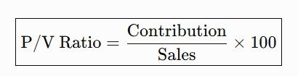

Cost-Volume-Profit (CVP) Analysis
Key formulae used in CVP & Break-even Analysis
4. Profit: It is the difference between total contribution and fixed costs.
5. Profit – Volume (P/V) Ratio: The P/V ratio measures contribution as a percentage of sales.
The P/V ratio indicates the contribution generated from every ₹1 of sales.
Example: A company sells a product with the following details.
Selling price = ₹500
Variable cost = ₹300
Contribution = ₹500 − ₹300 = ₹200
Therefore, P/V Ratio =
= 40%
It means that for every ₹100 of sales, the company generates ₹40 of contribution.

Slide 10



Cost-Volume-Profit (CVP) Analysis
Key formulae used in CVP & Break-even Analysis
6. Break-Even Point (BEP) – in Units: The break-even point (BEP) in units is the exact number of products a business must sell to cover all its costs and make zero profit or loss.
6. Break-Even Point (BEP) – in Sales Value: Sometimes management wants to know the rupee value of sales required to break even, rather than the number of units.
Example: A company has:
Fixed Cost = ₹2,00,000
P/V Ratio = 40%
Therefore, BEP ( Sales Value) =
BEP (Sales Value) = ₹5,00, 000

Slide 11

Cost-Volume-Profit (CVP) Analysis
Key formulae used in CVP & Break-even Analysis
7. Margin of Safety (MoS) – in Units: A company’s margin of safety is the difference between its current sales and its break-even sales.
The margin of safety tells the company how much it could lose in sales before the company begins to lose money.
In other words, before the company falls below the break-even point.
The higher the margin of safety is, the lower the risk is of not breaking even or incurring a loss.
Example: A company sells 10,000 units and has a break-even point (in units) of 6,000.
Therefore, MoS = 10,000 – 6,000 = 4,000 units.
So, the 4,000-unit margin of safety represents the company's cushion against a fall in sales volume.

Slide 12


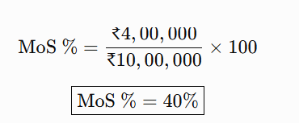
Cost-Volume-Profit (CVP) Analysis
Key formulae used in CVP & Break-even Analysis
8. Margin of Safety (MoS) – in Sales Value:
It can also be expressed as a percentage:
Example: A company’s sales are as follows:
Actual Sales = ₹10,00,000
Break-Even Sales = ₹6,00,000
Therefore, MoS = ₹10,00,000 – ₹6,00,000 = ₹4,00,000
This means actual sales can decline by 40% before the business reaches BEP.

Slide 13


Cost-Volume-Profit (CVP) Analysis
Key formulae used in CVP & Break-even Analysis
9. Sales Volume Required to Achieve a Target Profit
Example: A company’s reported sales and cost figures are as follows:
Selling price per unit = ₹500
Variable cost per unit = ₹300
Fixed costs = ₹12,00,000
Target profit = ₹8,00,000
The company wants to know how many units it must sell to earn ₹8,00,000 profit.
Contribution Per Unit: = ₹500 − ₹300 = ₹200
Required Sales to achieve target profit of ₹8,00,000:
= 10,000 units

Slide 14
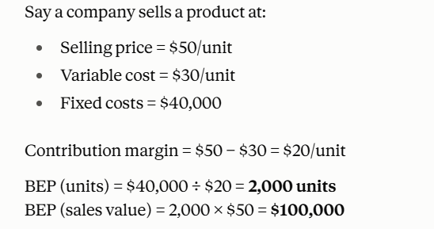
Cost-Volume-Profit (CVP) Analysis
Illustration:

Slide 15
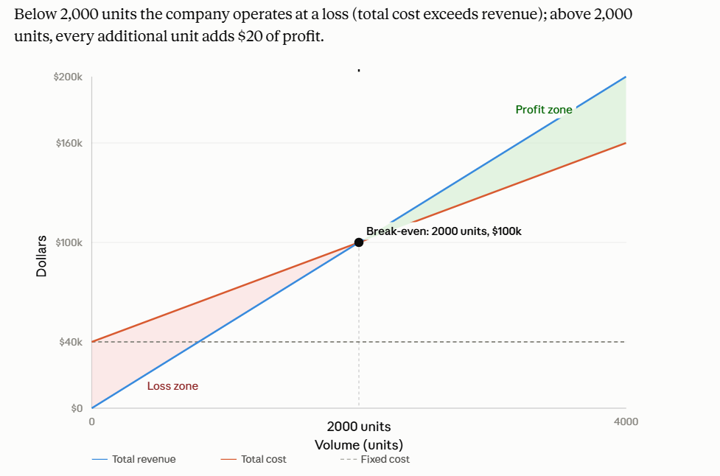
Illustration:
The revenue line (blue) starts at $0 and rises steeply — every unit sold adds $50.
The total cost line (orange) starts at $40,000 (the fixed cost) and rises more gently — every unit adds only $30.
The fixed cost line (dashed gray) stays flat at $40,000 regardless of volume.
Where the revenue and total cost lines cross is the break-even point: 2,000 units, $100,000 in sales.
Below that volume, the loss zone (red) shows total cost exceeding revenue.
Above it, the profit zone (green) shows revenue pulling ahead — and the gap between the two lines widens by $20 for every extra unit sold.

Slide 16
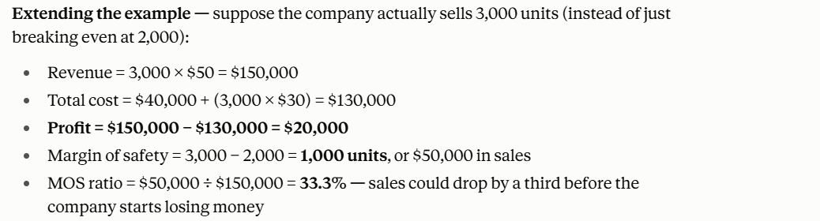
Illustration:

Slide 17
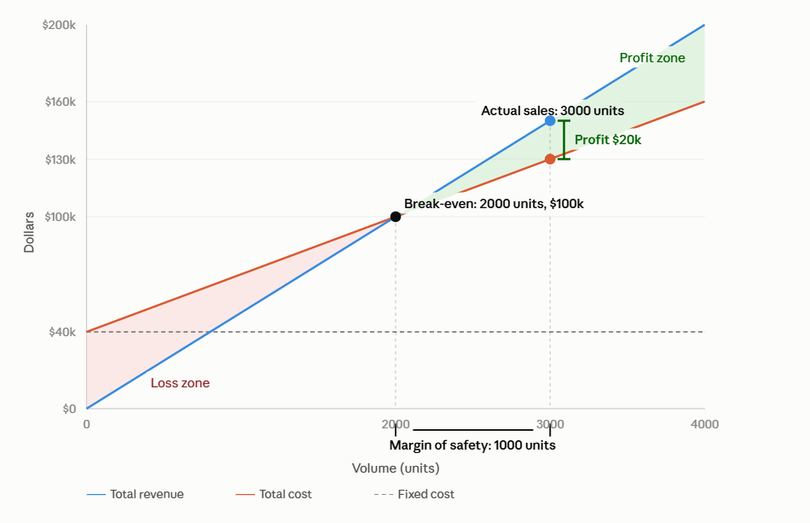
Illustration:
The red triangle is the loss zone — its height at any volume below 2,000 units is exactly how much the company is losing at that level of sales.
The green triangle is the profit zone — its height at any volume above 2,000 units is the profit at that level.
At 3,000 units (the actual sales point marked), the gap between the blue revenue line and the orange cost line is $20,000 — that's the profit,
The black bracket on the x-axis between the break-even point and the actual sales point is the margin of safety: 1,000 units, or $50,000 of sales cushion before the company would start losing money again.

Slide 18
Thank You!

